Slide 1
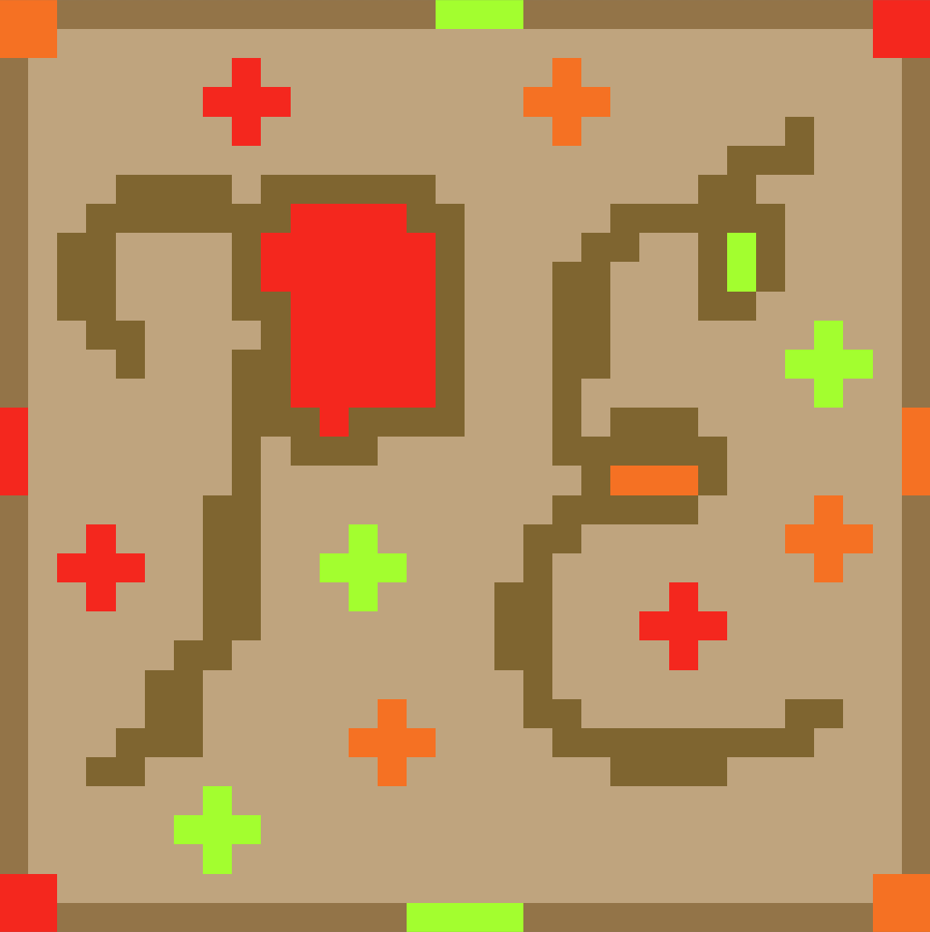
“Project: Egress”
Official & Finalized Logo made with Piskel:
Notes:
Ethan

Slide 2
What is “Project: Egress”?
Project Egress is a 2D platformer with a unique mechanic of paints.
Each paint type will grant a different type of effect
Ex. red - speed, orange - bounce, green - sticky
The player will progress through levels with the first one being basic without paints and the player will be introduced to new paints for levels 2-4.
The levels will get more challenging involving the use of multiple or all the different paints to get through.
Notes:
Maddie

Slide 3
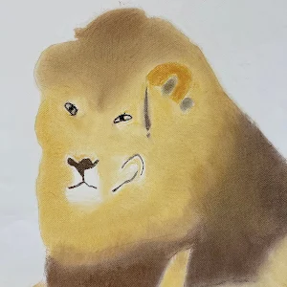


The Developers
Liam Bragg
Role: Lead Developer & Programmer
Ethan Todd
Role: Level-Creator, Artist, & Programmer
Madeline Rosshirt
Role: Programmer, Concept Artist, Level-Creator
Notes:
Ethan

Slide 4








Technologies/Languages Used
Notes:
Maddie

Slide 5
Current Progress - Scripts
Player movement
Moving left and right, jumping
Coyote Time - name inspired by Wile E. Coyote, allows the player to jump for a short period of time even after falling off a platform.
Jump Buffering - allows for early jump button presses to still be processed and make the player jump
Painting
In progress, each color has different effects. Currently working on making the paints be able to be applied to surfaces. The first paint effect will likely be red, which speeds up the player.
Checkpoints
The player will respawn here after touching it.
Respawning
Moves the player back to the respawn point, whether it is at the start of the level or at a checkpoint.
Platforming Tiles
These tiles are the default ground platforms that the player uses, and how it looks is randomized every time the level is loaded.
Notes:
Liam

Slide 6

Current Progress - Scripts
*There is no sound on the video.
Notes:
Liam

Slide 7
Current Progress - Level-Creation
Relatively slow
Only one person has been working on this primarily
Should speed up when more mechanics are done and more focus shifts in this direction
The more sprites and ideas are finished, the faster it should go
Learning took a little, but it should go faster now that significant time has passed
Levels
Level 1 has been the main focus
Level 1, in a way, is meant to be a movement demonstration/intro to player movement mechanics
Focus on movement mechanics in this level makes progress easier
Progress on future levels is dependant on more mechanics/ideas
Next level, and onward, should shift the focus more toward more traps & paint
Final level count is dependant on how quickly our focus will shift entirely on level-creation
Notes:
Ethan

Slide 8
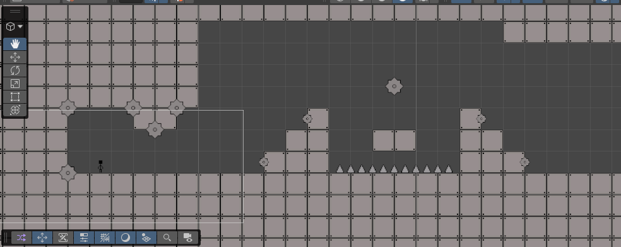
Current Progress - Level-Creation
Screenshot from Level 1: The Starting Room - Made with Unity Engine
Notes:
Ethan

Slide 9


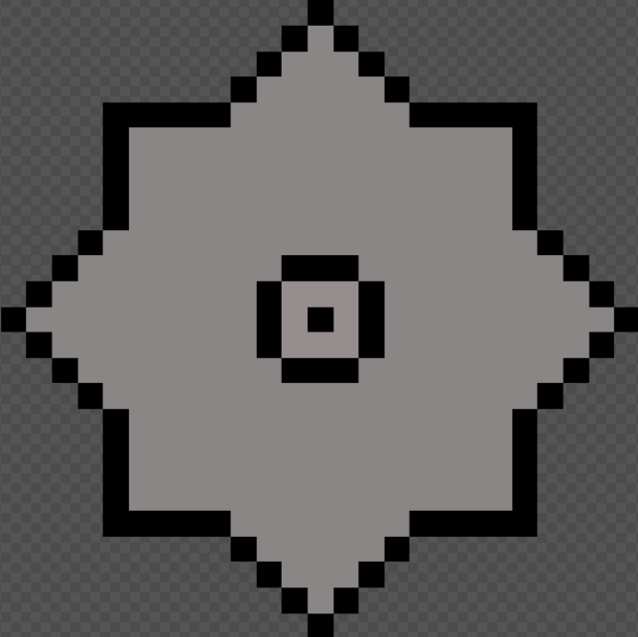

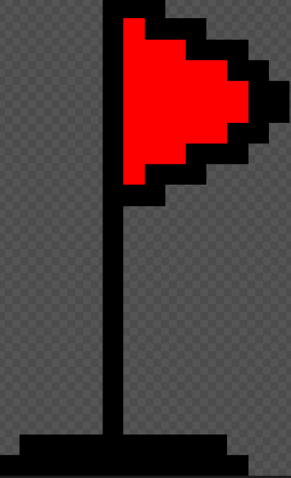
Current Progress - Sprites
All art is made through “Piskel”
Pixel style makes unique sprite creation easier
Images not to scale
Currently finished:
Tiles - likely finalized (most are done)
Traps - in progress (some are done)
In progress/placeholder:
Player character (medium priority)
Background tiles (medium to high priority)
Checkpoint (low priority)
To be done:
Paint (medium to high priority)
Paint tools (medium priority)
UI/Hud (low priority)
Title screen & pause screen (low priority)
Saw
Spike
Grey Tile
Player Character
Checkpoint
Notes:
Ethan

Slide 10

Challenges
Virtual Machines - Difficulties
VMs crashing
Unity errors
Git errors
VMs running slowly
Scripts - Bugs
Infinite jumping
Player having the ability to double jump for lots of height
Jumping up walls
Jumping off walls
Player only jumping a slight amount when moving against a wall
Floor bumps
Notes:
Liam, Maddie, & Ethan

Slide 11



High Priority Tasks
Finishing up Paint & Shooting
This is the main gimmick of the game…
3 paint types implemented and working
Paint switching
4 weapon types (if we get time)
Getting more levels done
Hard to do without paint and shooting
Sprite Work
Need at least a higher tech version of the current player as it needs to be shooting paint.
Menus and Level Select
Notes:
Maddie

Slide 12
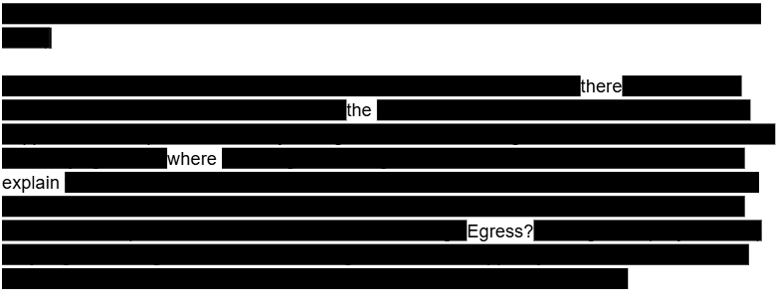
Reach Goals
Expanded Story
For now the player will most likely be given a plot synopsis but if time permits we can weave the story into the game.
Level Select to Sandbox
Instead of a boring menu you can travel freely and use all your paints in a sandbox area to select levels. Think something like the Kirby games.
Speedrun Feature
Pretty much just add a speedrun option with a timer and skippable cutscenes (if expanded story happens).
Level Editor (least likely)
Due to how we are making the game we would have to go out of the way to make a whole other interface for this.
Look it is a sneak peak of the story!
Notes:
Maddie

Slide 13
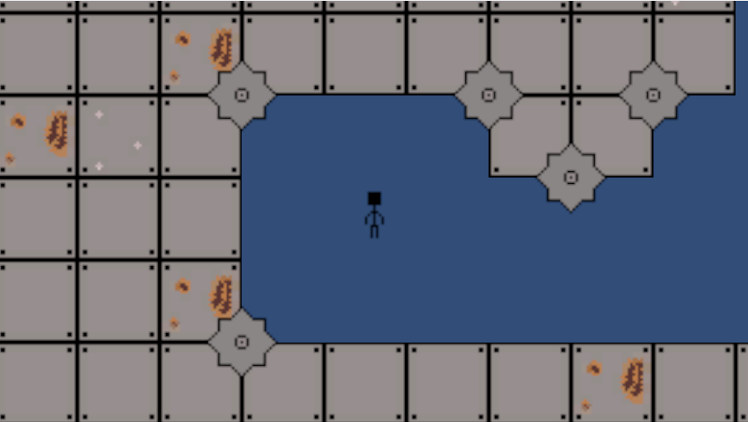
Tech Demo
https://github.com/Fennec427/Project-Egress
There is a tech demo that allows everyone to try it on their own!
See “Releases” on the right side of the GitHub repository.
Notes:
Liam

Slide 14
Thank You!
Any Questions?
Notes:
Ethan

